Slide 1

Crimes ‘n Keyboards
(Cyber security trends, and the challenge facing organisations today)

Slide 2
In the next 60 minutes – we will examine
1) Current trends
Cyber criminals are evolving. We’ll look at latest trends in what happens after a breach
2) The Cyber Attack Lifecycle (kill-chain)
An examination of the process of cyber breach - (and an example of fake news)
3) Fake news and AI bots to manipulate public opinion via social media.
Turing tests & trolling

Slide 3
Current trends in cyber crime
The evolving threat facing organisations today

Slide 4
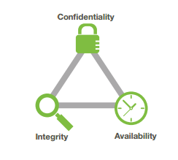
Defining cyber security
Cyber security = a focus on the CIA Triad
Think of the implications of the CIA triad for:
Facebook
Amazon
A school academy
A manufacturing company
A pensions fun

Slide 5
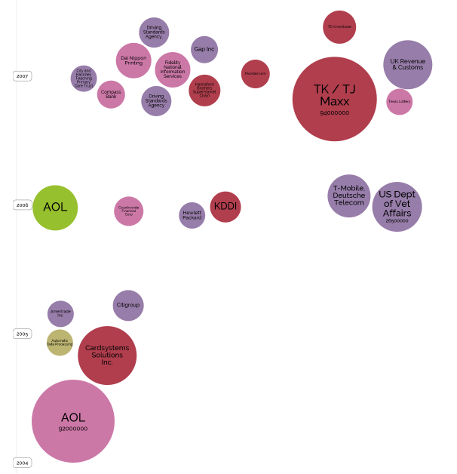
World’s biggest data breaches – 10 years ago
2007
accidentally published
hacked
inside job
lost/stolen device or media
Poor security
2006
2005
2005
Source: Information is Beautiful
Notes:
This information is taken from the “Information is Beautiful” website. Each one of these bubbles can be clicked on and more information is given about the data breach. The colours represent different types of attack, but what we can see is that 10 years or so ago, data breaches were fairly rare, and hacking in particular (the dark red colour) was still fairly unusual. If we bring that forward to now…the change is quite remarkable…

Slide 6
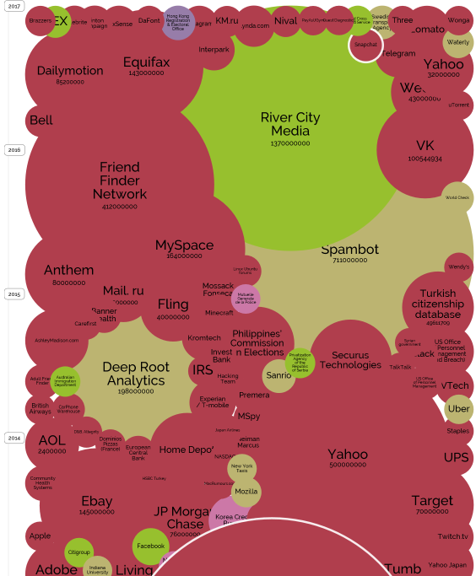
World’s biggest data breaches – now
2017
accidentally published
hacked
inside job
2016
lost/stolen device or media
Poor security
2015
2014
Source: Information is Beautiful
Notes:
It is now a sea of red, and the volume of data records that are affected is also much larger. There are no specific pension scheme organisations on here (yet), but you have got JP Morgan Chase back in 2014, and you’ve also got yahoo and aol, which are a concern if you have trustees who are using such email addresses to access scheme information and data.
The big story that is missing from here is Uber as we’ve not recaptured the page, but the uber breach affected 57 million data records. In that instance, they paid the hackers $100,000 on the understanding that they would keep quiet about it. The head of IT security for Uber is no longer the head of IT security for Uber…
So why is the picture so different? To understand that, we need to consider how the way we work has changed…

Slide 7
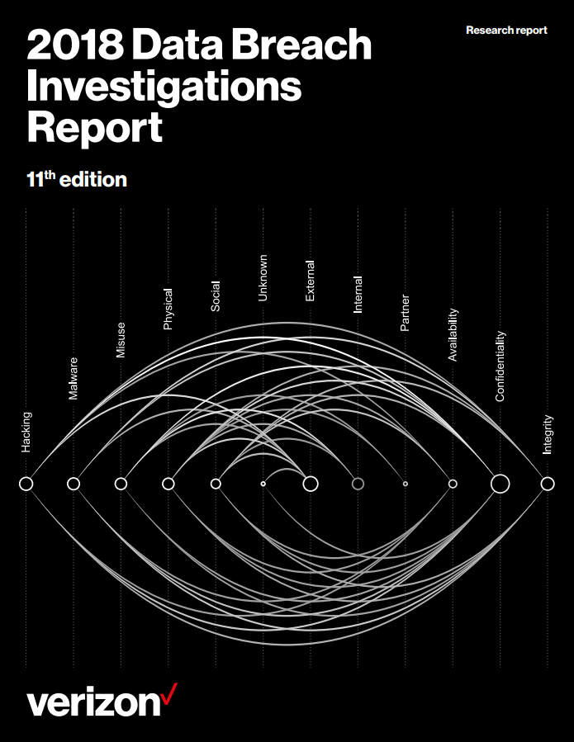
Reported cyber breaches, 2017
The extent of the (reported) problem
53,000 incidents
2,216 confirmed
breaches
73%
Perpetrated by outsiders
49% non PoS installed via email

Slide 8
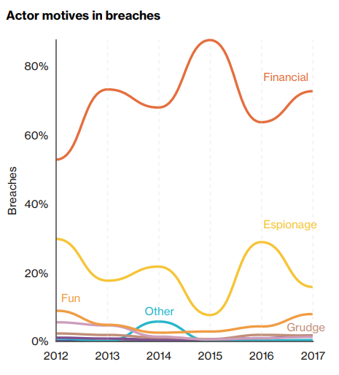
Actor motives in breaches
Hacking for profit
2.5billion user credentials breached (up 88%)
Ransomware (as a Service!)
Crypto-miners
Every component of the kill-chain exploited

Slide 9
Top External Actor varieties in breaches

Slide 10
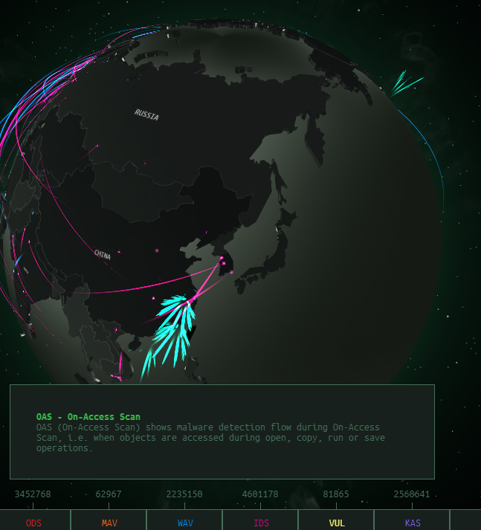
Who is conducting these attacks?
Probably everyone!
Attribution is difficult – IP addresses can be spoofed
Attribution is usually derived via motive, and code analysis
Your competitors want your intellectual property, then they want you off-line.
Other nations want silent access for espionage and infrastructure control.
Even if the attacker has no interest in you, they will attack you.

Slide 11
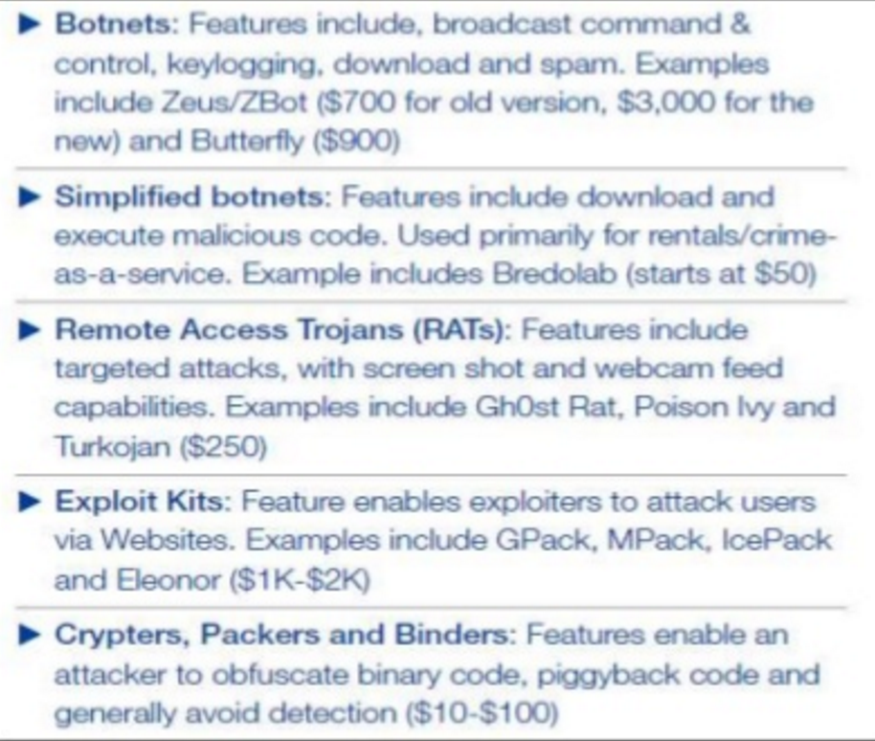
Ransomware campaign as an academic experience
PHD student - Jamison Utter | Palo Alto Networks Podcast - http://bit.ly/2cD53DL
Commodity Programming
Criminal elements are in constant reinvestment cycles expanding both footprint and technical ability.
Like real software most malware is developed in teams by technical coders specialized in the particular function.
Customer support, code support, and bug fix are now table stakes in professional malware.

Slide 12
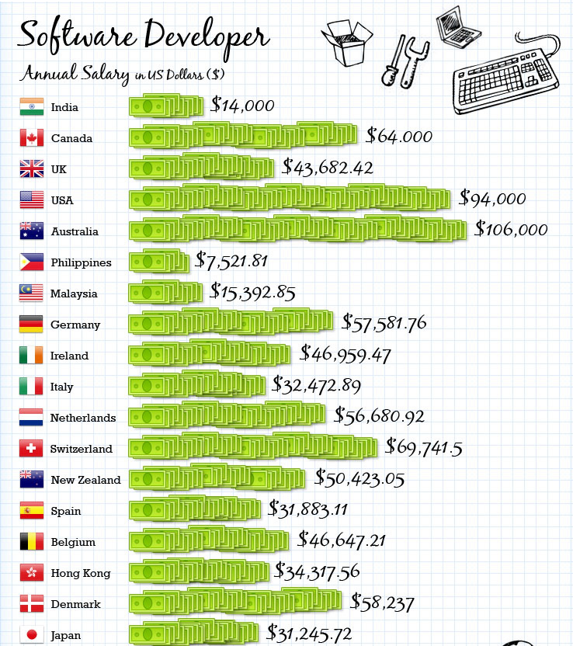
Scaled business model, motivated by $
“We’ve got kids to feed – what you do with our creation is up to you” - Ukrainian ransomware software developer (legitimate salary = $250 per month)
Coders
‘as a Service’ resellers
Help-desk support

Slide 13
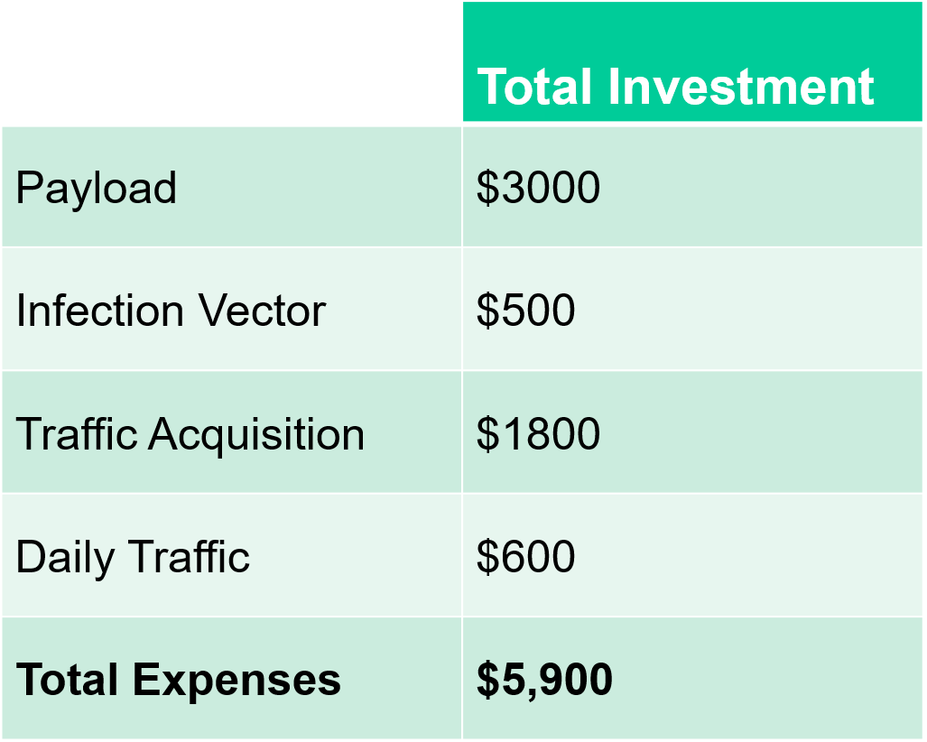
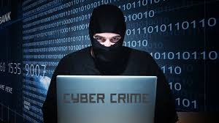
Ransomware campaign as an academic experience
PHD student - Jamison Utter | Palo Alto Networks Podcast - http://bit.ly/2cD53DL

Slide 14

What’s the Return on Investment?
Breaking it down
Item | Total Investment
Visitors | 20,000
Infection Rate | 10%
Payout rate | 0.5% (Symantec = 3%)
Ransom Amount | $300
ROI (Average 30 days) | $3,000/day ($90,000/month)

Slide 15
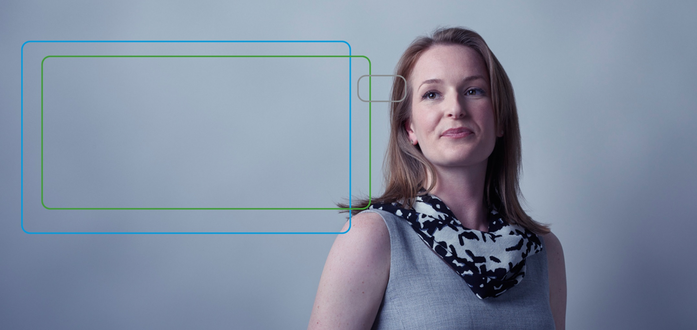
The Cyber Attack Lifecycle, aka:
Cyber kill-chain

Slide 16
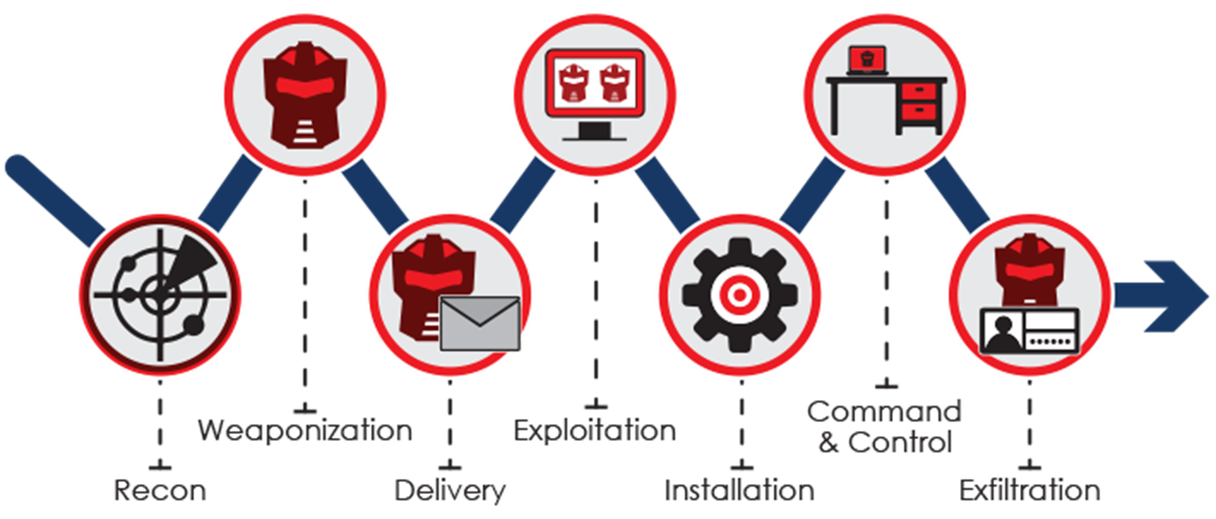
Cyber Kill Chain – the methodology of compromise
Cyber Kill Chain by Lockheed Martin

Slide 17
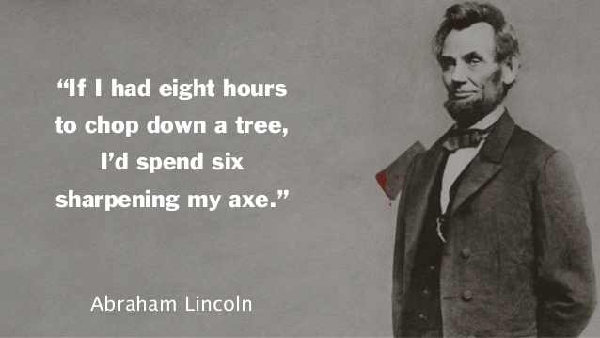
Reconnaissance is key

Slide 18
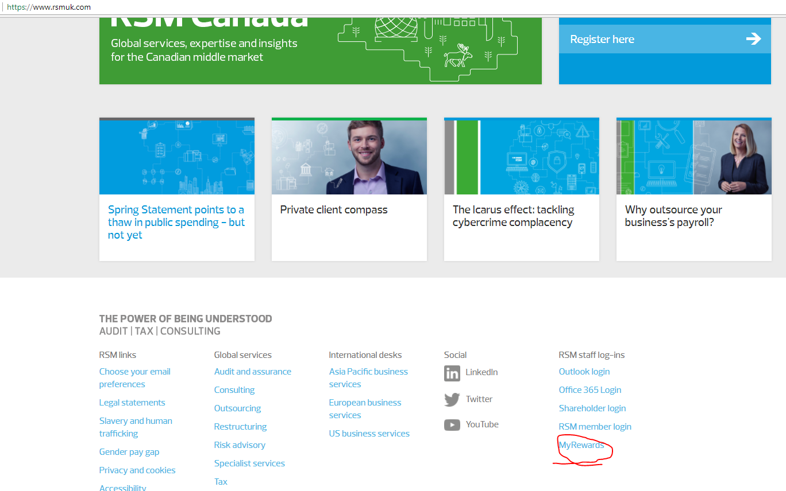
Hacking RSM
Employee benefits site is advertised on RSM public website

Slide 19
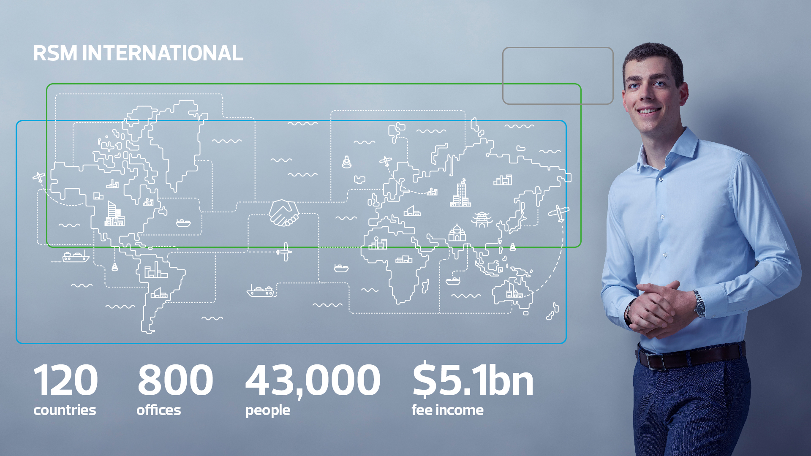

Slide 20
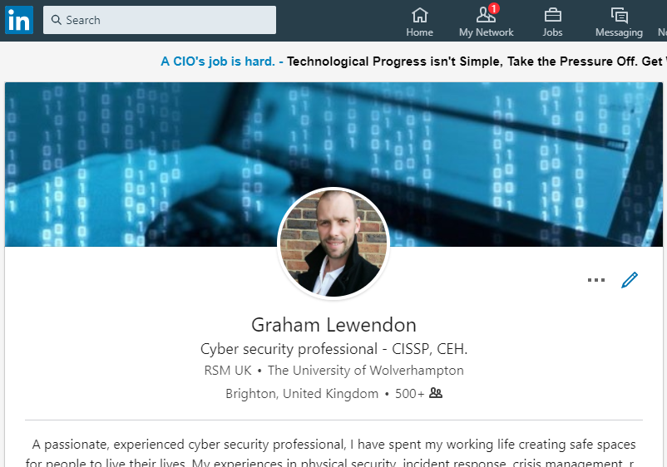
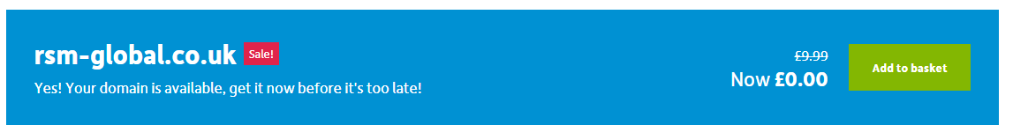
Identifying the means and the target

Slide 21
Digital Footprint Risk Assurance
OSINT report
Risk & Controls review
Phishing / Social Engineering
C-suite training
Notes:
Strategic OSINT research, detailed report, to include;
- Documents from search engines;
- Publicly disclosed suppliers and strategic partners
- Social media profiles.
- Lists of email addresses, and likely targets for social engineering contacts.
- Details of known password breaches (eg:- have I been pwned), highlighting where re-use of passwords could compromise individuals.
A simulated phishing or social engineering attack.
Help design technical and logical controls, focusing on financial controls (such as separation of duties, levels of financial authorisation and trust), network architecture designed with defence in depth at its core (cyber essentials / ISO27k), and appropriate reporting / flagging mechanisms for staff. a staff aware of the risks and types of targets and a culture of scepticism and reporting of incidents.
Educational cycle → provide awareness raising material to staff, and tailored education session(s) to C-Suite executives highlight the likely steps a hacker would take to target them.

Slide 22
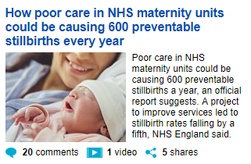
Turing test, your social media scraped & trolled
Scraping social media
Click bait
Turing test
Bots on social media

Slide 23
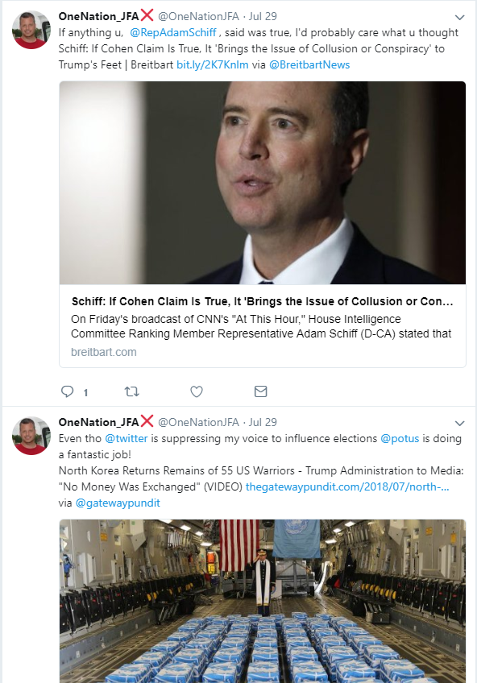
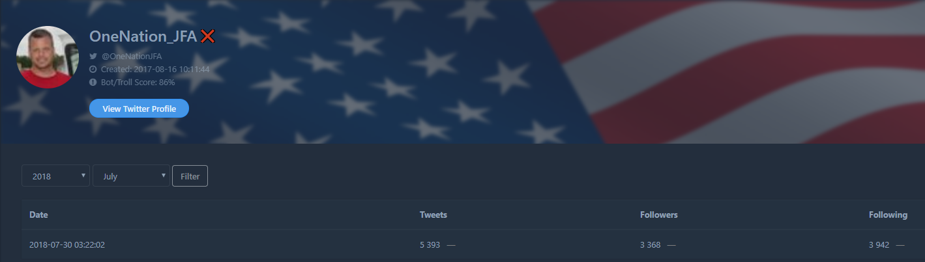
Created 16th October 2017
Tweets, as of 30th July 2018 = 5,393 (just over 15 tweets a day)

Slide 24
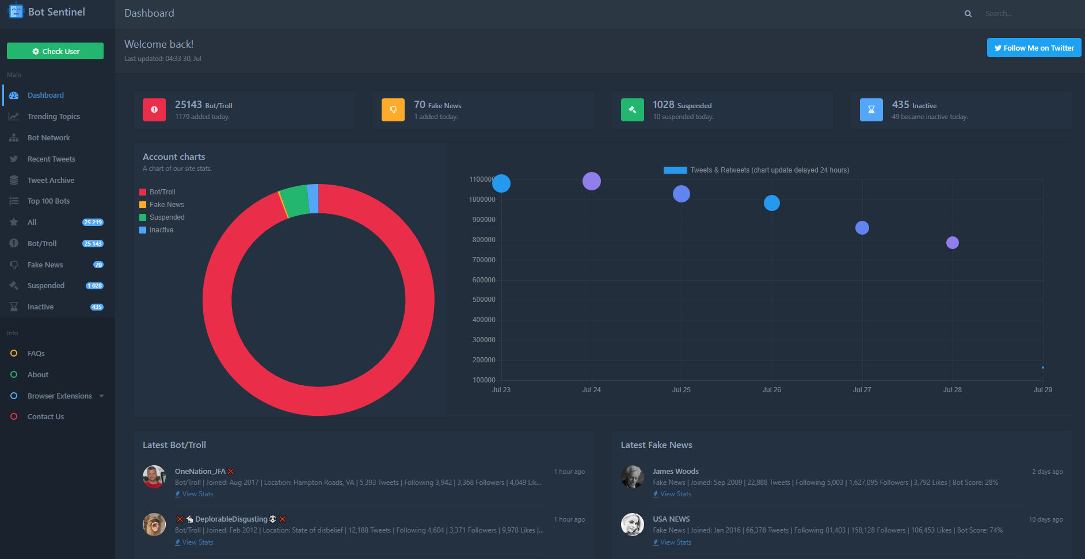
Identifying twitter troll bots = https://botsentinel.com/
Twitter troll accounts today = 1179 by 9.36am

Slide 25
The take-aways:
How to protect yourself
Do not re-use passwords. Use a unique password for every account. Either a Pass-phrase stump followed by account specific addendum; eg- Pink-Dotty-Cup1Fb (for Facebook) Pink-Dotty-Cup1Az (for Amazon) - or - Use a password manager, such as LastPass
Install updates as soon as they’re available to install
Have a good back-up strategy. Back-up your data using the cloud with some ability to roll back (OneDrive does this), or back-up offline eg: with an external hard-drive, and then unplug that drive from your computer.

Slide 26
QUESTIONS AND ANSWERS?

